Slide 1
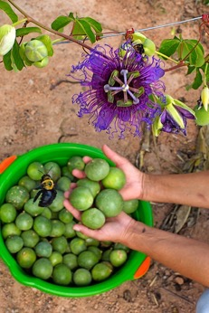
South-South Cooperation Conference on Sustainable Consumption and Production – IFAD Global Strategy and SSTC Best Practices
Brasília, Brazil
6-7 April 2017
Notes:
Estimado Senhoras e Senhores, boa tarde. Em primeiro lugar gostariamos de agradecer ao Leonel da CEERI pelo convite para que o FIDA fizesse parte desse painel com agencias internacionais financiadoras da agricultura no Brasil.

Slide 2
UNEP South-South Cooperation Conference
What does IFAD do?
IFAD is both a specialized agency of the United Nations (UN) as well as an international financial institution (IFI)
Since its creation in 1977, IFAD has focused exclusively on rural poverty reduction, working with poor rural populations in developing countries to eliminate poverty, hunger and malnutrition; raise their productivity and incomes; and improve the quality of their lives.
The Fund provides loans on highly-concessional, intermediate and ordinary terms to developing countries to finance innovative agriculture and rural development projects and programs. Lending conditions vary according to the borrower’s GNI per capita.
IFAD provides also grants to institutions and organizations in support of activities to strengthen the technical and institutional capacities linked to agricultural and rural development.
Notes:
IFAD is currently governed by 176 States among Africa, Asia, Oceania, the Americas and Europe
Since 1978, IFAD has mobilized almost US$43 billion of investments and co-financing in agricultural and rural development
1,013 programmes and projects across 123 countries
Approximately 459 million people empowered to grow more food, better manage their land and other natural resources, learn new skills, start small businesses, build strong organizations and gain a voice in the decisions that affects their lives

Slide 3
IFAD’s Portfolio in Numbers
IFAD is the unique International Financing Institution – IFI - for Agriculture of the United Nations System. It is among the world’s 10 largest Multilateral Development Banks.
It was founded in 1977 to mobilize resources for investment in agriculture and rural poverty alleviation.
IFAD portfolio under implementation, including co-financing:
World= US$ 17.6 billion (total historic); US$ 13 bln (on-going)
Latin America= US$ 1.5 billion (on-going)
Brazil= US$ 450 million for 350.000 families

Slide 4
UNEP South-South Cooperation Conference
Partnerships are central to IFAD’s work.
IFAD’s partners include Member States; civil society organizations, particularly those of smallholders farmers and rural people; UN agencies (in particular the 2 other RBAs); bilateral and multilateral development agencies; agricultural research centers; NGOs and foundations; policy research institutes and universities; regional organizations; and the private sector.
IFAD also brokers partnerships among the diverse parties working in development and for South-South and triangular co-operation.
How does IFAD work?
Notes:
Member States provide the financial resources for the operations through the Replenishments.
IFAD established dedicated offices to guide, manage and monitor all aspects of the Replenishment process. The Tenth Replenishment of IFAD Resources (IFAD10) will cover the 2016-2018 period with an agreed financing of US$1.44 billion.
Financial resources come also from the reimbursement of loans and from the profits of investments.

Slide 5
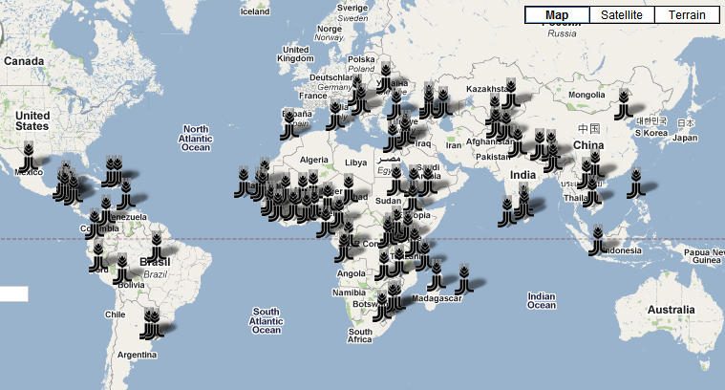
UNEP South-South Cooperation Conference
IFAD is currently working on 231 projects in 98 countries around the world
NEN
APR
LAC
WCA
ESA
40 Country Offices are supporting operations in the field and 10 more will be opened soon

Slide 6
UNEP South-South Cooperation Conference
Vision: Inclusive transformation and sustainable inclusion of the rural poor
Overall Objective: overcome poverty and reach food security
and sustainability
Specific objectives:
Increase productive capacities;
Improve access to markets;
Reinforce environmental sustainability and resilience to climate change
The new IFAD corporate strategy ( 2016 -2025)

Slide 7
UNEP South-South Cooperation Conference
IFAD’s SSTC Objectives
As SSTC is a means to an end, IFAD has defined 2 SSTC objectives to support the organization in achieving its strategic objectives:
SSTC Objective 1: to enable rural poor people, public and private sector actors, civil society, research centers, universities and other institutions originating from developing countries to share relevant solutions, information, data and financing for improve rural livelihoods.
SSTC Objective 2: to promote partnerships and collaboration mechanisms between rural people, public and private sector actors, civil society, research centers, universities and other institutions in the rural sector originating from developing countries.
Notes:
The IFAD Strategic Framework 2016-2025 has 3 Strategic Objectives:
(i) increase poor rural people’s productive capacities;
(ii) increase poor rural people’s benefits from market participation; and
(iii) strengthen the environmental sustainability and climate resilience of poor rural people’s economic activities

Slide 8
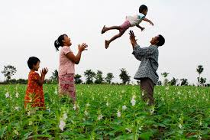
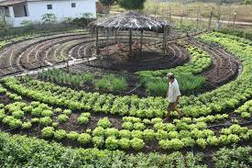
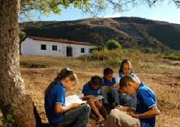
UNEP South-South Cooperation Conference
IFAD’s SSTC activities
To achieve the 2 IFAD’s SSTC objectives, IFAD undertakes a range of activities that are closely coordinated to ensure that each intervention is not an ad hoc activity. Thus, the Fund undertakes SSTC activities broadly with the aim of generating improvements in:
Knowledge and/or skills
Engagement
Connectivity
Resource mobilization
Notes:
(i) Knowledge and/or skills: Public and private sector actors, civil society, and poor rural people are more productive due to a change in awareness, attitude, or understanding; due to a new or developed skill or adopted technology acquired through an SSTC activity.
(ii) Engagement: Public and private sector actors, civil society, and poor rural people with a common interest or agenda are more effective in influencing policy debates due to enhanced collaboration, strengthened knowledge, improved attitudes, shared understanding resulting from an SSTC activity.
(iii) Connectivity: Public and private sector actors, civil society, and poor rural people are able to take action as a result of a new or improved relationships, greater empathy, developed trust, and diminished isolation, as a result of IFAD’s SSTC initiative.
(iv) Resource mobilization: Public and private sector actors, civil society, and poor rural people benefit from increased financial, in-kind, intellectual and human resources originating from government, business, multilateral and other sources originating from the Global South.

Slide 9
UNEP South-South Cooperation Conference
Policy Level:
Supporter of Mercosur’s REAF (the Specialized Meeting on Family Farming) in Latin America, for the transfer of agricultural know-how and technology
Lao and South Korea policy grant supporting best practices for a better participatory policy development process;
Brazil Forum of Secretaries of Family Farming for coordinated rural development policies;
Regional and inter-regional level: Supported the Agricultural Innovation Marketplace in Latin America and Africa in partnership with EMBRAPA and other institutions, and the development of East-East ‘corridors’ of technical exchange among Eastern European and Middle Eastern countries.
Examples of SSTC in the context of IFAD’s specificity

Slide 10
UNEP South-South Cooperation Conference
Family Farming Project Level:
The well-known ‘Learning Routes’, in partnership with PROCASUR, a non-profit organization focused on knowledge management among people linked to development projects, associations, organizations and governments;
Rural Finance and family farming, e.g. in the Southern Cone (Argentina, Uruguay);
Cooperativism and family farming, e.g. Brazil (Bahia)
Water reuse and micro-irrigation. Brazil Federal Project (Projeto Dom Helder Camara, phase I); Guatemala, India and Madagascar; Oases technology transfer Mauritania and Morocco; The Upper Tana-Nairobi Water Fund (UTNWF).
Better management of environmental resources, Renewable Energy Technologies (RETs), solar energy etc, contributing to the attainment of the SDG 12.
Inter-agency: CGIAR partners (i.e. ICRAF, CIAT, ICRISAT, IMWI, Potato Centre, etc.) , World Bank (Joint Supervision Missions in Brazil)
Examples of SSTC in the context of IFAD’s specificity

Slide 11
UNEP South-South Cooperation Conference
Conclusion
IFAD actively promotes the scaling-up of its best practices, which are often incorporated into official rural development policies at national and international level. IFAD also strives to expand its collaboration with the private sector, ranging from research, product supply and technology institutions, further contributing to giving family farming products a wider and more profitable and efficient market access.
IFAD is also leading in the strengthening of more robust M&E systems (monitoring and evaluation systems) of rural development projects worldwide, including a more rational and efficient use of environmental resources, leading to more effective project management and a more rapid achievement of the SDGs, in particular the SDG 12.

Slide 12
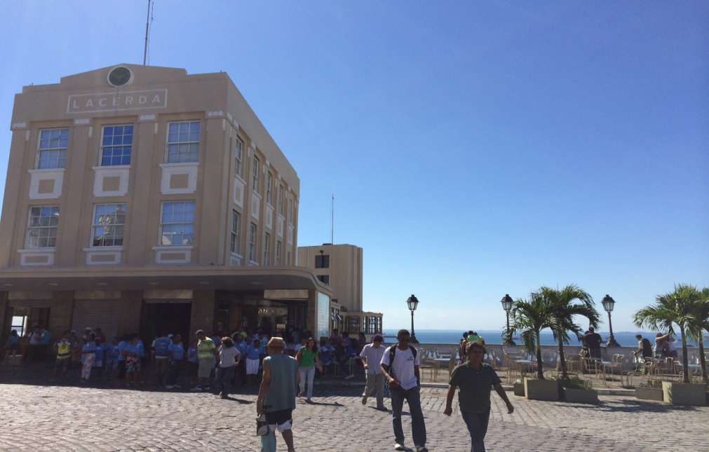
Obrigado!
IFAD– International Fund for Agricultural Development
Via Paolo di Dono, 44, Roma, Italy
Brasil:
Escritório Compartilhado das Nações Unidas
Praça Municipal Thomé de Souza, S/N, Edifício Elevador Lacerda
CEP 40.020-010
Salvador-BA, Brasil
Tel. (+5571) 3183-5715/5700
www.fida.org.br
www.ifad.org

